Slide 1
How We Got the Bible

Slide 2
Inspired By God
2 Timothy 3:16-17 16 Every Scripture is God-breathed and profitable for teaching, for reproof, for correction, and for instruction in righteousness, 17 that each person who belongs to God may be complete, thoroughly equipped for every good work.

Slide 3
Writing Materials
Stone
Plaster
Clay
Wood/Wax
Metal
Papyrus
Parchment/Vellum

Slide 4
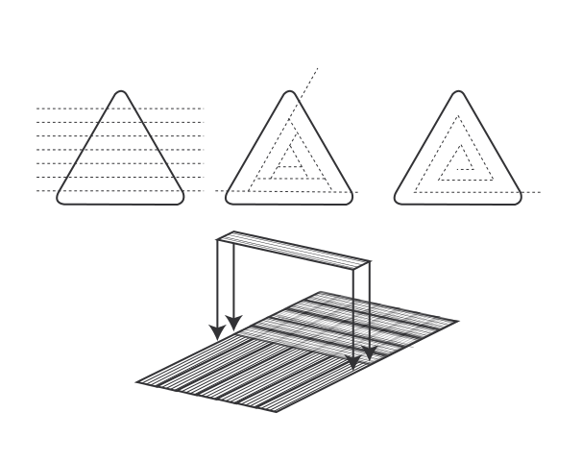
Making Papyrus
By Aethralis - Own work, CC BY-SA 3.0, https://commons.wikimedia.org/w/index.php?curid=11098485

Slide 5
Forms
Scrolls
Codex

Slide 6
Languages
Hebrew
Aramaic
Greek

Slide 7
Evidences
Manuscripts
Lectionaries
References/Quotes
Translations

Slide 8
Ancient Manuscripts
Autographs
Papyri
Uncials
Minuscules

Slide 9
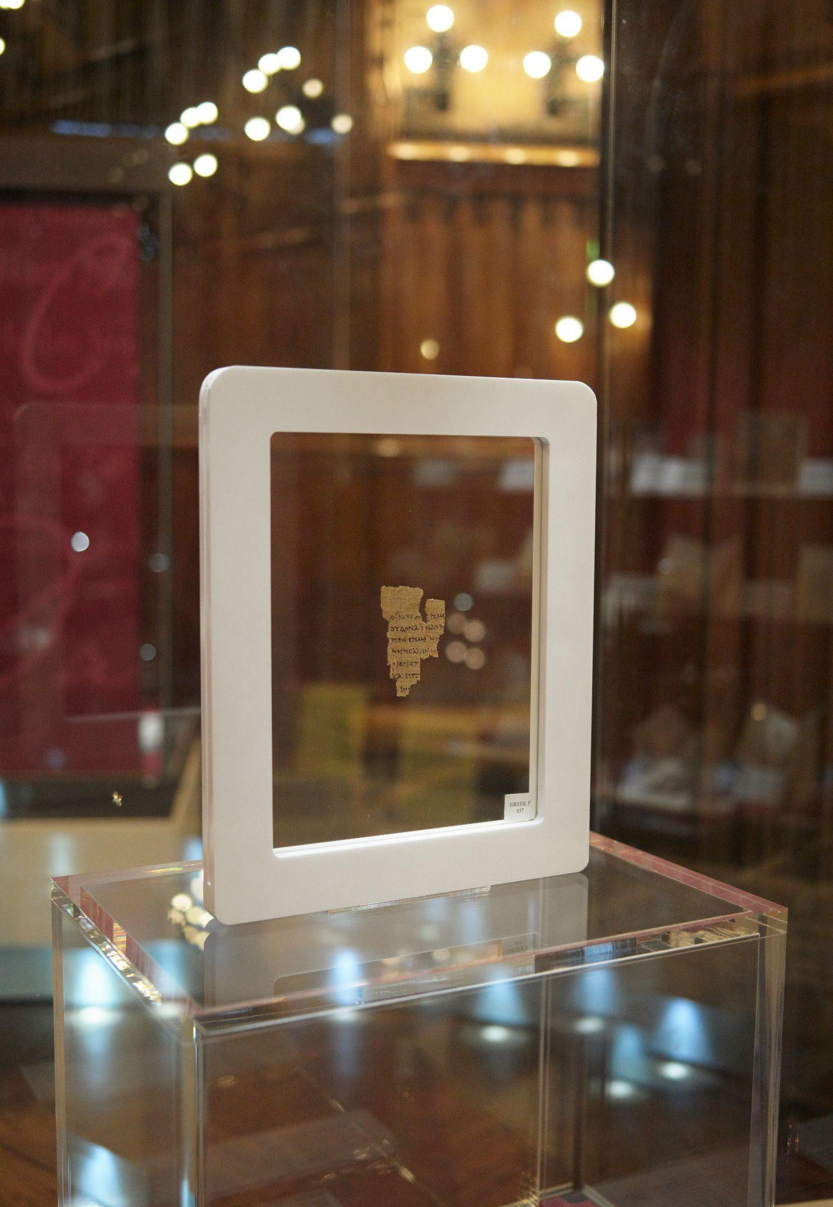
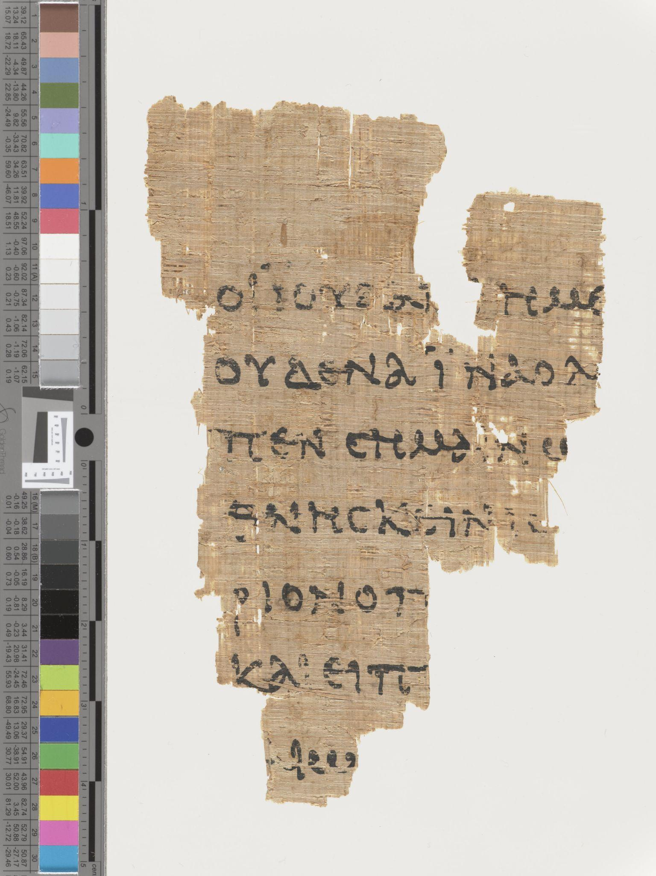
Ryland P52 Papyrus Fragment of John
John 8:31-31 and John 8:37-38
From around 125 to 150 AD
RylandsImaging, CC BY-SA 4.0 <https://creativecommons.org/licenses/by-sa/4.0>, via Wikimedia Commons
By RylandsImaging - Own work, CC BY-SA 4.0, https://commons.wikimedia.org/w/index.php?curid=81155279

Slide 10
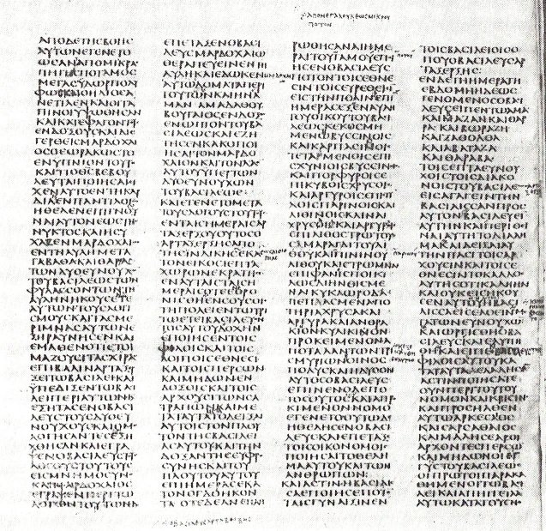
Uncial

Slide 11
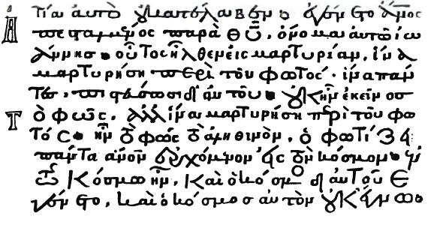
Minuscule

Slide 12
Variations
Simple errors
Substitution
Added/Omitted Connecting Words
Word Order
Eye Skipping
Spelling Variations
Significant Variations in One Manuscript
Margin Notes
Margin References
Harmonize
Significant Additions

Slide 13
Textual Criticism
Systematic Approach to Getting the Text Right

Slide 14
Major Manuscripts
Codex Vaticanus
Codex Sinaiticus
Codex Alexandrinus

Slide 15
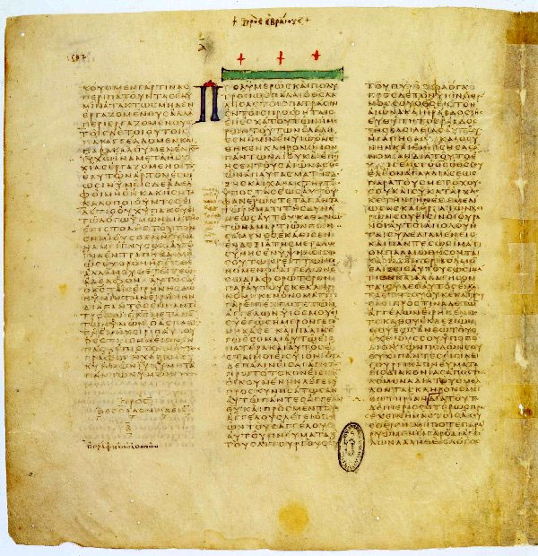
Codex Vaticanus

Slide 16
Codex Sinaiticus

Slide 17
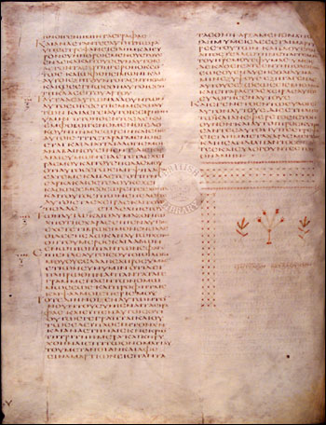
Codex Alexandrinus

Slide 18
Canon
1 John 4:1 Beloved, don’t believe every spirit, but test the spirits, whether they are of God, because many false prophets have gone out into the world.

Slide 19
Greek Texts
Textus Receptus (Received Text)
Wescott-Hort

